Slide 1
Working Memory Model
Baddeley and Hitch (1974) developed an alternative model of short-term memory which they called working memory

Slide 2
Working memory
Working memory is short-term memory. Instead of all information going into one single store, there are different systems for different types of information. Working memory consists of a central executive which controls and coordinates the operation of two subsystems: the phonological loop and the visuo-spatial sketch pad.

Slide 3
Central Executive
Central Executive: Drives the whole system (e.g. the boss of working memory) and allocates data to the subsystems (VSS & PL). It also deals with cognitive tasks such as mental arithmetic and problem solving.

Slide 4
Visuo-Spatial Sketchpad
Visuo-Spatial Sketchpad (inner eye): Stores and processes information in a visual or spatial form. The VSS is used for navigation.
The sketch pad also displays and manipulates visual and spatial information held in long-term memory. For example, the spatial layout of your house is held in LTM. Try answering this question: How many windows are there in the front of your house? You probably find yourself picturing the front of your house and counting the windows. An image has been retrieved from LTM and pictured on the sketch pad.

Slide 5
phonological loop
The phonological loop is the part of working memory that deals with spoken and written material. It can be used to remember a phone number. It consists of two parts
o Phonological Store (inner ear) – Linked to speech perception Holds information in speech-based form (i.e. spoken words) for 1-2 seconds.
o Articulatory control process (inner voice) – Linked to speech production. Used to rehearse and store verbal information from the phonological store.

Slide 6
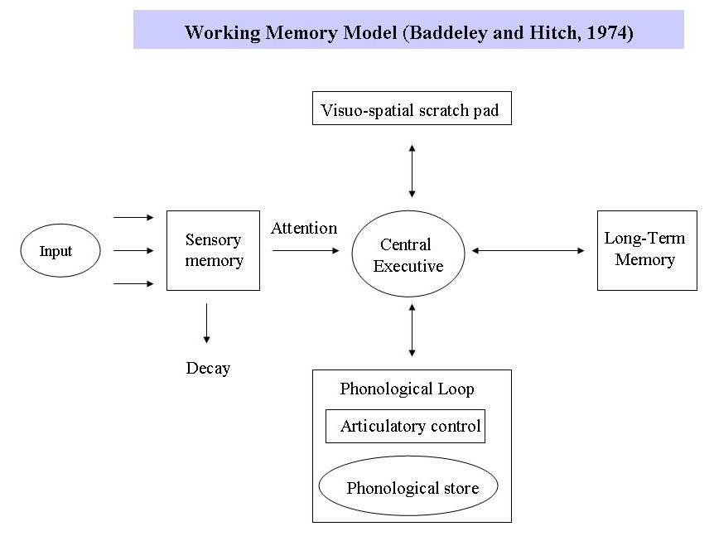

Slide 7
The central Executive
The central executive decides what working memory pays attention to. For example, two activities sometimes come into conflict such as driving a car and talking. Rather than hitting a cyclist who is wobbling all over the road, it is preferable to stop talking and concentrate on driving. The central executive directs attention and gives priority to particular activities.
The central executive is the most versatile and important component of the working memory system. However, despite its importance in the working-memory model, we know considerably less about this component than the two subsystems it controls.
Baddeley suggests that the central executive acts more like a system which controls attentional processes rather than as a memory store. This is unlike the phonological loop and the visuo-spatial sketch pad, which are specialized storage systems. The central executive enables the working memory system to selectively attend to some stimuli and ignore others.

Slide 8
Evaluation of Working Memory
Researchers today generally agree that short-term memory is made up of a number of components or subsystems. The working memory model has replaced the idea of a unitary (one part) STM as suggested by the multistore model.

Slide 9
Strengths
The working memory model explains a lot more than the multistore model. It makes sense of a range of tasks - verbal reasoning, comprehension, reading, problem solving and visual and spatial processing. And the model is supported by considerable experimental evidence.
The working memory applies to real life tasks:
- reading (phonological loop)
- problem solving (central executive)
- navigation (visual and spatial processing)
The KF Case Study supports the Working Memory Model. KF suffered brain damage from a motorcycle accident that damaged his short-term memory. KF's impairment was mainly for verbal information - his memory for visual information was largely unaffected. This shows that there are separate STM components for visual information (VSS) and verbal information (phonological loop).
Working memory is supported by dual task studies(Baddeley and Hitch, 1976).
The working memory model does not over emphasize the importance of rehearsal for STM retention, in contrast to the multi-store model.

Slide 10
Weaknesses
Lieberman (1980) criticizes the working memory model as the visuo-spatial sketch pad (VSS) implies that all spatial information was first visual (they are linked). However, Lieberman points out that blind people have excellent spatial awareness although they have never had any visual information. Lieberman argues that the VSS should be separated into two different components: one for visual information and one for spatial.
There is little direct evidence for how the central executive works and what it does. The capacity of the central executive has never been measured.
Working memory only involves STM so it is not a comprehensive model of memory (as it does not include SM or LTM).
The working memory model does not explain changes in processing ability that occur as the result of practice or time.

